Slide 1
Data Structure and algorithm X Stack and Queue
Kevin Feng

Slide 2
Previous Review
Data Structure and Algorithm
Mathematical Review
Array
Array List
Recursive vs. Iterative
Binary Search
Divide and Conquer
Linked List

Slide 3
Overview
Stack
Data Member
Operations
Queue
Data Member
Operations

Slide 4
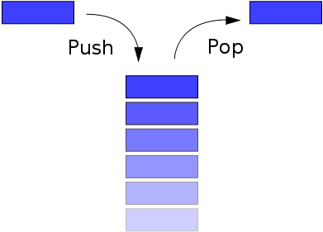
Stack Basic Idea
Last in, First out (LIFO)
Operations:
Push: adds an item to the top of the stack, hiding any items already on the stack
Pop: removes an item from the top of the stack, and returns this value to the caller
The stack is usually implemented with more operations
Size: returns the current number of items on the stack
Peek: return the current top element of the stack without removing it
A stack can be easily implemented either through an array or a linked list

Slide 5
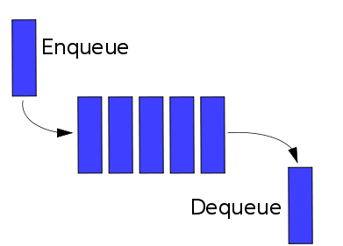
Queue Basic Idea
First in, First out (FIFO)
Operations:
Enqueue: adds an item to the end of the queue
Dequeue: removes an item from the front of the queue
The stack is usually implemented with more operations
Size: returns the current number of items on the queue
Peek: return the current top element of the queue without removing it.
A queue can be easily implemented either through a (circular) array or a linked list

Slide 6
Practice I
Implement Queue using Stacks (232E)
Implement Stack using Queues (225E)
Min Stack (155E)
Design a stack that supports push, pop, top, and retrieving the minimum element in constant time.
getMin() -- Retrieve the minimum element in the stack.
Two Stack with One Array
Describe how you could use a single array to implement two stacks
Three Stack with One Array
Describe how you could use a single array to implement three stacks
Stack Sorting
Write a program to sort a stack in ascending order. You should not make any assump­tions about how the stack is implemented. The following are the only functions that should be used to write this program: push | pop | peek | isEmpty.

Slide 7
Practice II
Reverse a String
Palindrome
Valid Parentheses (20E)
Given a string containing just the characters '(', ')', '{', '}', '[' and ']', determine if the input string is valid
Simplify Path (71M)
Given an absolute path for a file (Unix-style), simplify it.
For example, path = "/home/" => "/home" path = "/a/./b/../../c/" => "/c"

Slide 8
Practice III
Decode String
Given an encoded string, return it's decoded string.
The encoding rule is: k[encoded_string], where the encoded_string inside the square brackets is being repeated exactly k times. Note that k is guaranteed to be a positive integer.
You may assume that the input string is always valid; No extra white spaces, square brackets are well-formed, etc.
Furthermore, you may assume that the original data does not contain any digits and that digits are only for those repeat numbers, k. For example, there won't be input like 3a or 2[4].
Examples:
s = "3[a]2[bc]", return "aaabcbc".
s = "3[a2[c]]", return "accaccacc".
s = "2[abc]3[cd]ef", return "abcabccdcdcdef".

Slide 9
Practice IV
Baseball Game
You're now a baseball game point recorder.
Given a list of strings, each string can be one of the 4 following types:
Integer (one round's score): Directly represents the number of points you get in this round.
"+" (one round's score): Represents that the points you get in this round are the sum of the last two valid round's points.
"D" (one round's score): Represents that the points you get in this round are the doubled data of the last valid round's points.
"C" (an operation, which isn't a round's score): Represents the last valid round's points you get were invalid and should be removed.
Each round's operation is permanent and could have an impact on the round before and the round after.
You need to return the sum of the points you could get in all the rounds.
Input: ["5","2","C","D","+"]
Output: 30
Round 1: You could get 5 points. The sum is: 5.
Round 2: You could get 2 points. The sum is: 7. Operation 1: The round 2's data was invalid. The sum is: 5.
Round 3: You could get 10 points (the round 2's data has been removed). The sum is: 15.
Round 4: You could get 5 + 10 = 15 points.
The sum is: 30.

Slide 10
Practice V
Asteroid Collision
We are given an array asteroids of integers representing asteroids in a row.
For each asteroid, the absolute value represents its size, and the sign represents its direction (positive meaning right, negative meaning left). Each asteroid moves at the same speed.
Find out the state of the asteroids after all collisions. If two asteroids meet, the smaller one will explode. If both are the same size, both will explode. Two asteroids moving in the same direction will never meet.
Example 1:
Input: asteroids = [5, 10, -5]
Output: [5, 10]
Explanation: The 10 and -5 collide resulting in 10. The 5 and 10 never collide.
Example 3:
Input: asteroids = [10, 2, -5]
Output: [10]
Explanation: The 2 and -5 collide resulting in -5. The 10 and -5 collide resulting in 10.

Slide 11
Practice VI
Next Greater Element
Given an array, print the Next Greater Element for every element. The Next greater Element for an element x is the first greater element on the right side of x in array. Elements for which no greater element exist, consider next greater element as -1.
Next Greater Element II
Given a circular array (the next element of the last element is the first element of the array), print the Next Greater Number for every element. The Next Greater Number of a number x is the first greater number to its traversing-order next in the array, which means you could search circularly to find its next greater number. If it doesn't exist, output -1 for this number.

Slide 12
Practice VII
Daily Temperatures
Given a list of daily temperatures, produce a list that, for each day in the input, tells you how many days you would have to wait until a warmer temperature. If there is no future day for which this is possible, put 0 instead.
For example, given the list temperatures = [73, 74, 75, 71, 69, 72, 76, 73], your output should be [1, 1, 4, 2, 1, 1, 0, 0].
Deque (Two Side Stack/Queue)
Whereas a stack allows insertion and deletion of elements at only one end, and a queue allows insertion at one end and deletion at the other end, a deque (double-ended queue) allows insertion and deletion at both ends. Write four O(1)-time procedures to insert elements into and delete elements from both ends of a deque constructed from an array.
Sliding Window Maximum (239H)
Given an array nums, there is a sliding window of size k which is moving from the very left of the array to the very right. You can only see the k numbers in the window. Each time the sliding window moves right by one position.
For example, Given nums = [1, 3, -1, -3, 5, 3, 6, 7], and k = 3
Therefore, return the max sliding window as [3, 3, 5, 5, 6, 7]

Slide 13
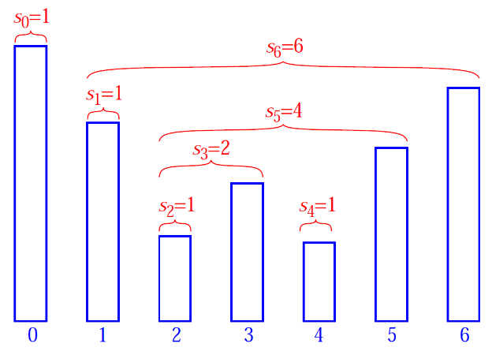
Homework
Length of Longest Valid Substring
Given a string consisting of opening and closing parenthesis, find length of the longest valid parenthesis substring.
Stock Span Problem
The span S_{i} of the stock’s price on a given day i is defined as the maximum number of consecutive days just before the given day, for which the price of the stock on the current day is less than or equal to its price on the given day.

Slide 14
Project
Arithmetic Expression Evaluation
Evaluate an expression represented by a String. Expression can contain parentheses, you can assume parentheses are well-matched. For simplicity, you can assume only binary operations allowed are +, -, *, and /.
Arithmetic Expressions can be written in one of three forms:
Infix Notation: Operators are written between the operands they operate on, E.g., 3 + 4 .
Prefix Notation: Operators are written before the operands, E.g., + 3 4
Postfix Notation: Operators are written after operands. E.g., 3 4 +
Converting from infix to postfix
Evaluating a postfix expression

Slide 15
Review
Stack and Queue
ArrayList Implementation
LinkedList Implmentation
Sample Interview Questions

Slide 16
Data Structure and algorithm X Stack and queue THE END

